Slide 1
Exception handling and debugging
Continous staff improvement
Sergiu Grajdean

Slide 2
OBjectives
Exception concept
Throwing Exceptions in C#
try Statements and Exceptions
The catch Clause
The finalLy block
Key Properties of System.Exception
Exceptions VS Error codes
Debugging
Watch window
Immediate Window
Call Stack Window
Conditional Compilation
System.Diagnostics Namespace
Var-Implicitly Typed Local Variables

Slide 3
Exception concept
Exceptions are the standard mechanism for reporting errors
Exceptions are replacement for error codes
Throwing an exception interrupts execution of current statement and pass the control to exception handler
Exception contains information about the error and the state of program when the error occurred

Slide 4
Throwing Exceptions in C#
All exception in C# inherits from Exception class
To throw an exception throw keyword is used
Example
Exception exception = new Exception();
throw exception;

Slide 5
Throwing Exceptions in C#
Example – throw ArithmeticException to avoid divide by zero operation.
Example – Check for null input parameters
public double Divide(int dividend, int divisor)
{
if (divisor == 0)
throw new ArithmeticException("Attempted to divide by zero.");
double result = dividend / divisor;
return result;
}
public void Save(User user)
{
if (user == null) throw new ArgumentNullException("user");
// More code...
}

Slide 6
try Statements and Exceptions
A try statement specifies a code block subject to error-handling or cleanup code
The try block must be followed by a catch block, a finally block, or both
The catch block executes when an error occurs in the try block
The finally block executes after execution leaves the try block (or if present, the catch block), to perform cleanup code, whether or not an error occurred

Slide 7
try Statements and Exceptions
try
{
... // exception may get thrown within execution of this block
}
catch (ExceptionA ex)
{
... // handle exception of type ExceptionA
}
catch (ExceptionB ex)
{
... // handle exception of type ExceptionB
}
finally
{
... // cleanup code
}

Slide 8
The catch Clause
A catch clause specifies what type of exception to catch. This must either be System.Exception or a subclass of System.Exception
It is possible to have more than one catch clause
The order of catch clauses meters – catch the more specific exceptions before the less specific ones
catch clause can be used without arguments to catch any type of exception, this usage is not recommended
try
{
throw new Exception("Demo exception");
}
catch
{
}

Slide 9

How to catch

Slide 10
The catch Clause
Example
try
{
Foo();
}
catch (ArithmeticException exception)
{
Log(exception);
throw new Exception("An error occurred. See the inner exception for more details", exception);
}
catch (Exception exception)
{
Log(exception);
throw;
}

Slide 11
The catch Clause
How to catch correctly
catch (Exception exception)
{
DoStuff(exception);
throw exception; // will clear the stack trace
}
catch (Exception exception)
{
DoStuff(exception);
throw; // will alter a bit the stack trace, may be redundant
}
catch (Exception exception)
{
DoStuff(exception);
throw new IWantToHaveMyOwnException("message", exception);
//keeps original stack trace, adds new info to the exception
}

Slide 12
catch WHEN
try
{
}
catch (TimeoutException) when (retryCount++ < limit)
{
}
catch (IOException e) when (e.HResult == fileUsedByAnotherProcess)
{
}

Slide 13
The finalLy block
A finally block always executes – whether or not an exception is thrown and whether or not the try block runs to completion
finally blocks are typically used for cleanup code
A finally block executes either:
After a catch block finishes
After control leaves the try block because of a jump statement (e.g., return or goto)
After the try block ends
The only things that can defeat a finally block are an infinite loop, or the process ending abruptly

Slide 14
The finalLy block
Example
Stream file = null;
try
{
file = File.Open("myfile.txt", FileMode.Open);
}
finally
{
if (file != null)
{
file.Dispose();
}
}
Notes:
Looks familiar?

Slide 15
Key Properties of System.Exception
The most important properties of System.Exception are the following:
StackTrace – A string representing all the methods that are called from the origin of the exception to the catch block.
Message – A string with a description of the error.
InnerException – The inner exception (if any) that caused the outer exception. This, itself, may have another InnerException.

Slide 16
Exceptions VS Error codes
Return codes are more verbose
Return codes are more brittle
Return Codes must sometimes be translated
Return Codes are not an universal solution
Return Codes means you can't chain expressions
Exception are typed

Slide 17
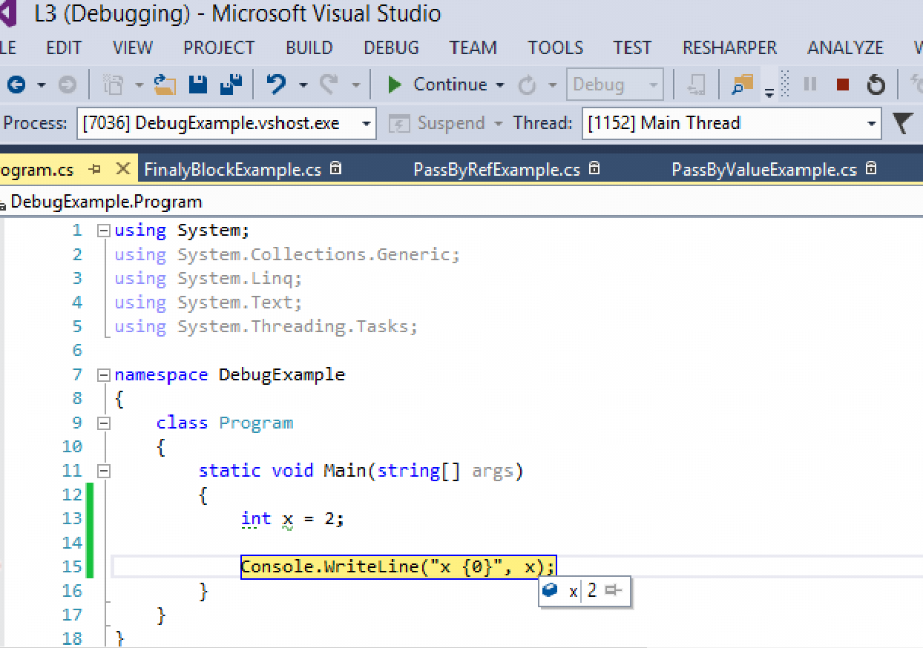
Debugging
Debugging is a methodical process of finding and reducing the number of bugs, or defects, in a computer program or a piece of electronic hardware
Debugger.Break – Signals a breakpoint to an attached debugger.

Slide 18
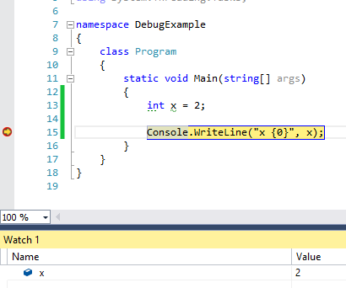
Watch window
Watch window allows evaluate variables and expressions and keep the results
Watch window allows edit the value of a variable or register
To open Watch Window : from the Debug menu, choose Windows, then Watch, and click on Watch1, Watch2, Watch3, or Watch4.

Slide 19
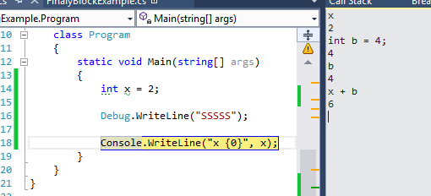
Immediate Window
The Immediate window is used to debug and evaluate expressions, execute statements, print variable values, and so forth.
The Immediate window allows to enter expressions to be evaluated or executed by the development language during debugging

Slide 20
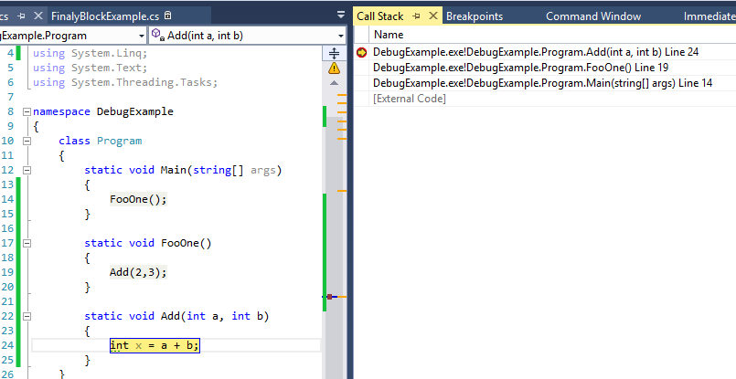
Call Stack Window
The Call Stack window allows viewing the function or procedure calls that are currently on the stack.
The Call Stack window displays the name of each function and the programming language that it is written in

Slide 21
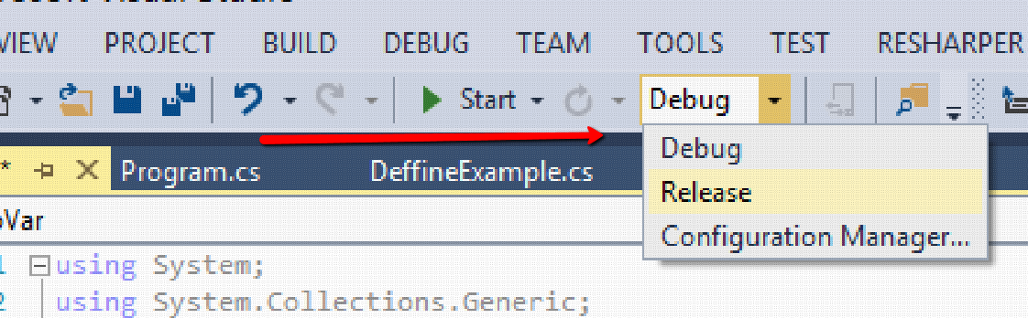
Conditional Compilation
Preprocessor directives are special instructions to the compiler that begin with the # symbol
The #if directive instructs the compiler to ignore a section of code unless a specified symbol has been defined
A symbol can be defined with either the #define directive or a compilation switch
By default each Visual Studio project has two Configurations :
DEBUG
RELEASE

Slide 22
Conditional Compilation
Compilation switch
#define MYCONDITION
using System;
namespace DebugExample
{
class DeffineExample
{
#if MYCONDITION
void Foo()
{
Console.WriteLine("Hi");
}
#endif
}
}

Slide 23
Conditional Compilation
Conditional attribute
[Conditional("MYCONDITION")]
void Foo()
{
Console.WriteLine("Hi");
}

Slide 24
System.Diagnostics Namespace
The System.Diagnostics namespace provides classes that allow you to interact with system processes, event logs, and performance counters.
The EventLog component provides functionality to write to event logs, read event log entries, and create and delete event logs and event sources on the network.
The Process class provides functionality to monitor system processes across the network, and to start and stop local system processes.
The PerformanceCounter class enables you to monitor system performance, while the PerformanceCounterCategory class provides a way to create new custom counters and categories.
The System.Diagnostics namespace also provides classes that allow you to debug your application and to trace the execution of your code – Trace and Debug classes

Slide 25
Var-Implicitly Typed Local Variables
Beginning in Visual C# 3.0, variables that are declared at method scope can have an implicit type var. An implicitly typed local variable is strongly typed just as if you had declared the type yourself, but the compiler determines the type.
public DemoVar()
{
var x = 4; // x is of type int
var user = new User(); // user is of type User
}

Slide 26
Assignment
Create methods which checks input Arguments and throws exceptions
Create custom exceptions and throw them
Write Try-catch-Finally block with multiple catch statements
Use Catch WHEN Filter
Rethrow exception
Add conditional compilation SYMBOLS
Use debug/TRACE class to write debug information to output window
Declare implicit typed variable using keyword var

Slide 27
References
Albahari J, Albahari B (2012). C# 5.0 in a Nutshell.
try-catch (C# Reference)
Exceptions and Exception Handling
Watch Window
Immediate Window
How to: Use the Call Stack Window
sealed (C# Reference)
10.5.5 Sealed methods

Slide 28
Revisions
Number | Author | Date | Description
1.0.0 | Serghei Grajdean | 07.12.2015 | Initial version
1.1.0 | Serghei Grajdean | 19.02.2016 | Sealed methods slide moved to another presentation. Minor changes.
1.1.1 | Marian Bejenari | 12.07.2018 | What happens to stacktrace when you re-throw. Catch when filter.

